Slide 1

‘Always Song in the Water is an imaginative exploration of the oceanic

Slide 2
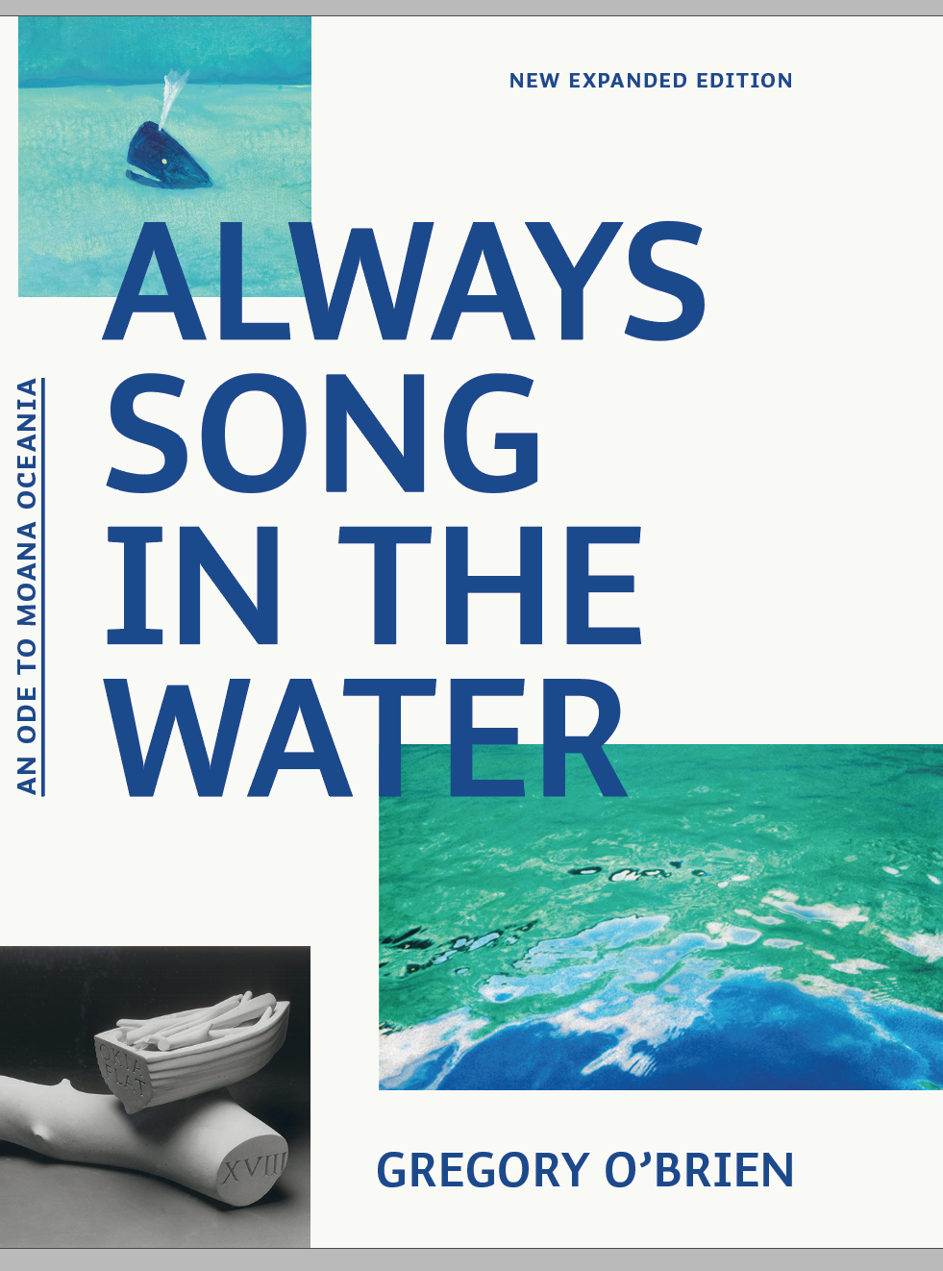

Always Song in the Water is an imaginative exploration of the oceanic environment which links Aotearoa New Zealand, the islands of the Pacific and Japan.
The touring exhibition celebrates – in images, words and sound – our connectedness with wider Oceania, its peoples, flora, fauna and the expansive waters which both inspire and define us.
The exhibition is based on a book
that was republished in 2023

Slide 3
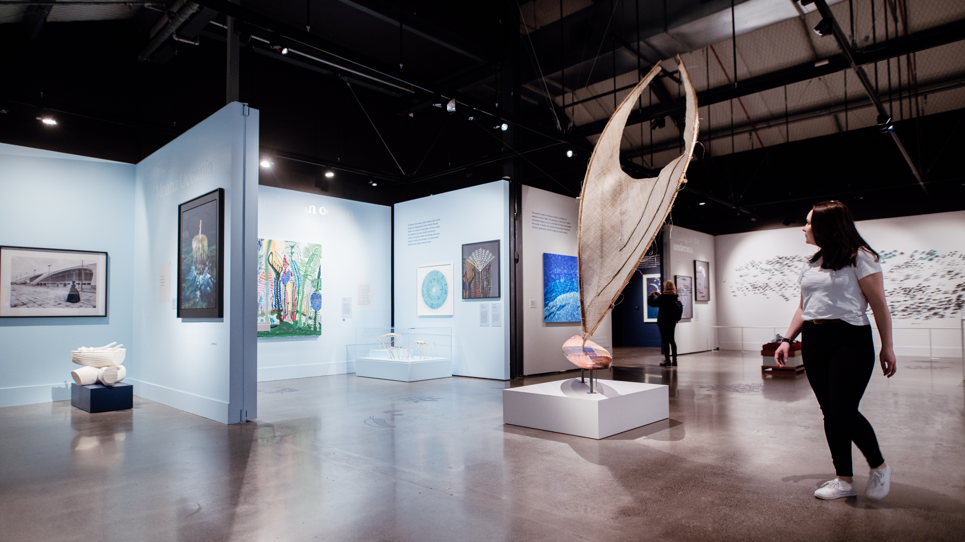
The exhibition is structured around 7 key themes.
Works included are by prominent artists across Moana Oceania (New Zealand, Australia, Pacific Islands):
Robin White, Elizabeth Thomson, John Pule, Fiona Hall, Noel McKenna, Kazu Nakagawa and more
The layout and design are fluid: the number and selection of works can be adjusted; works can be added, or removed, to suit the size and shape of galleries.

Slide 4
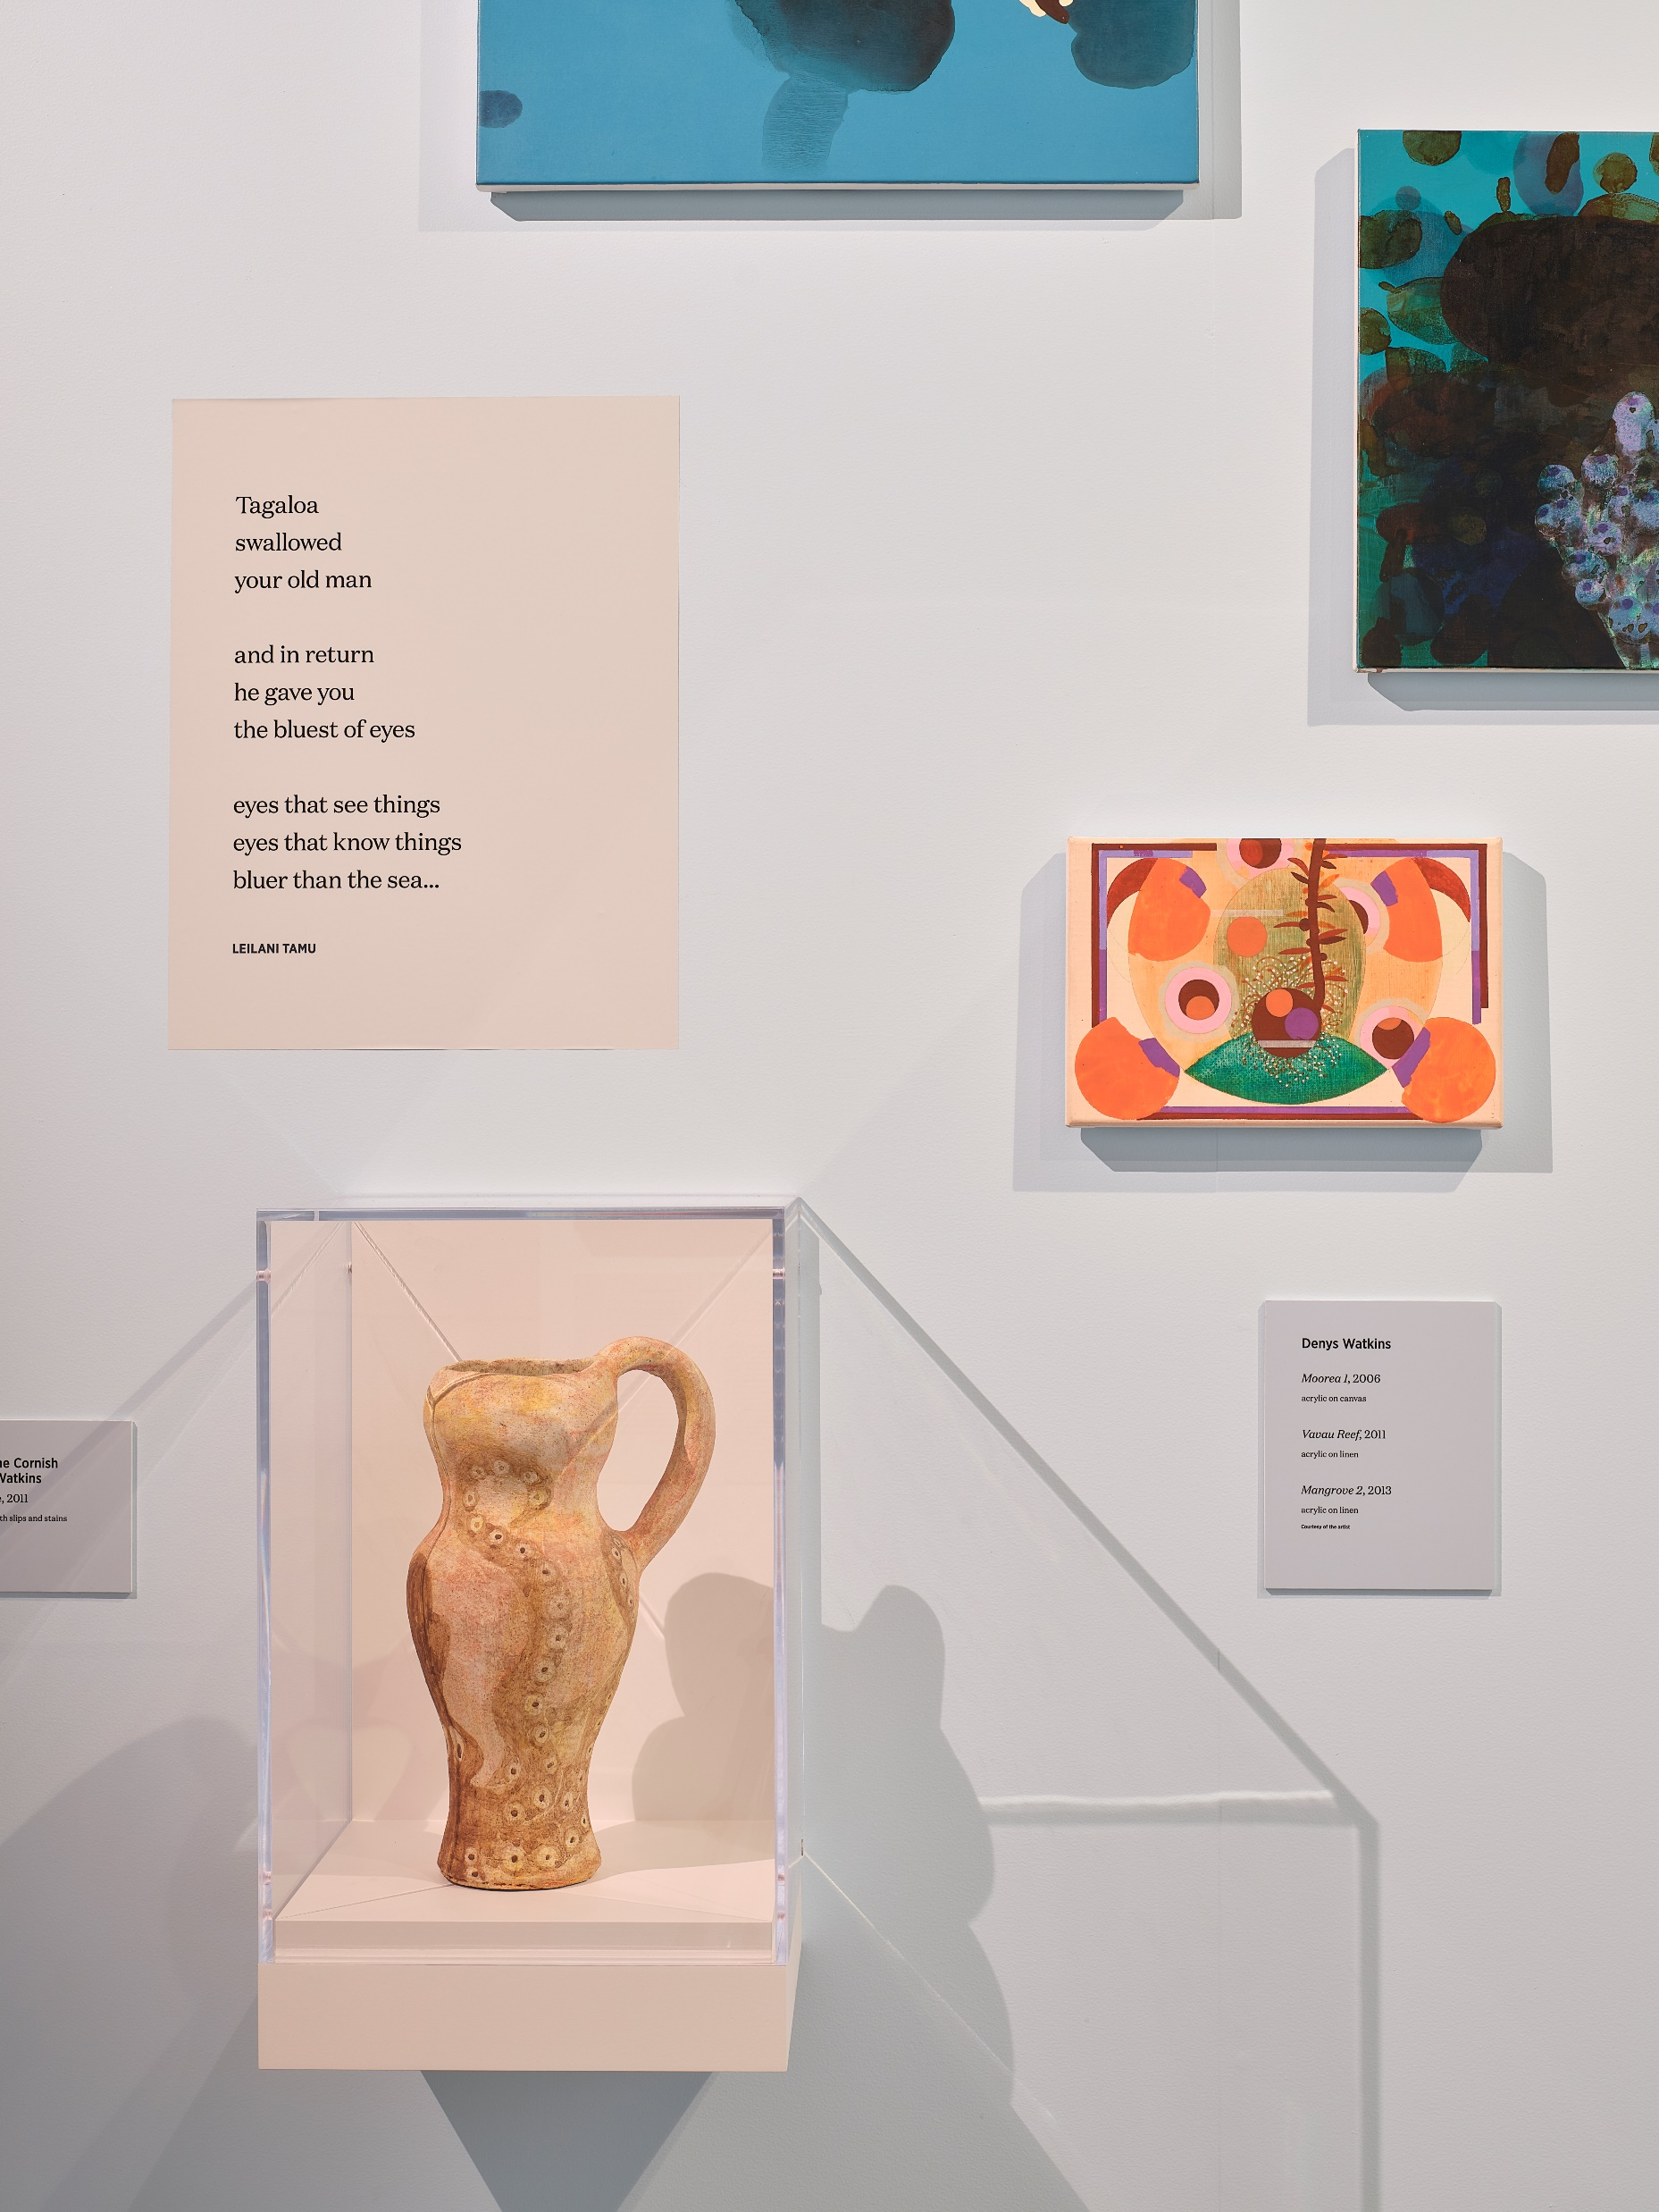
Artworks range from large installations to smaller prints, paintings, jewellery, and photography. Artists’ working drawings and ephemera could be displayed in vitrines or wall cases.
The exhibition design also includes poetry.

Slide 5
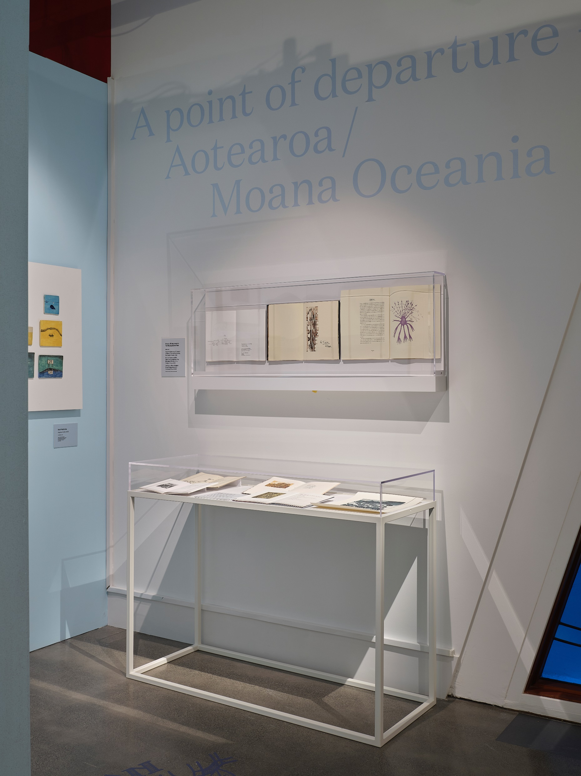
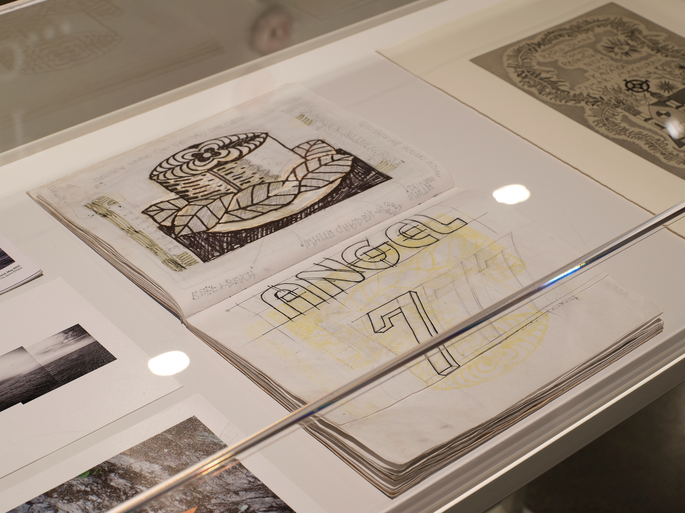

Slide 6
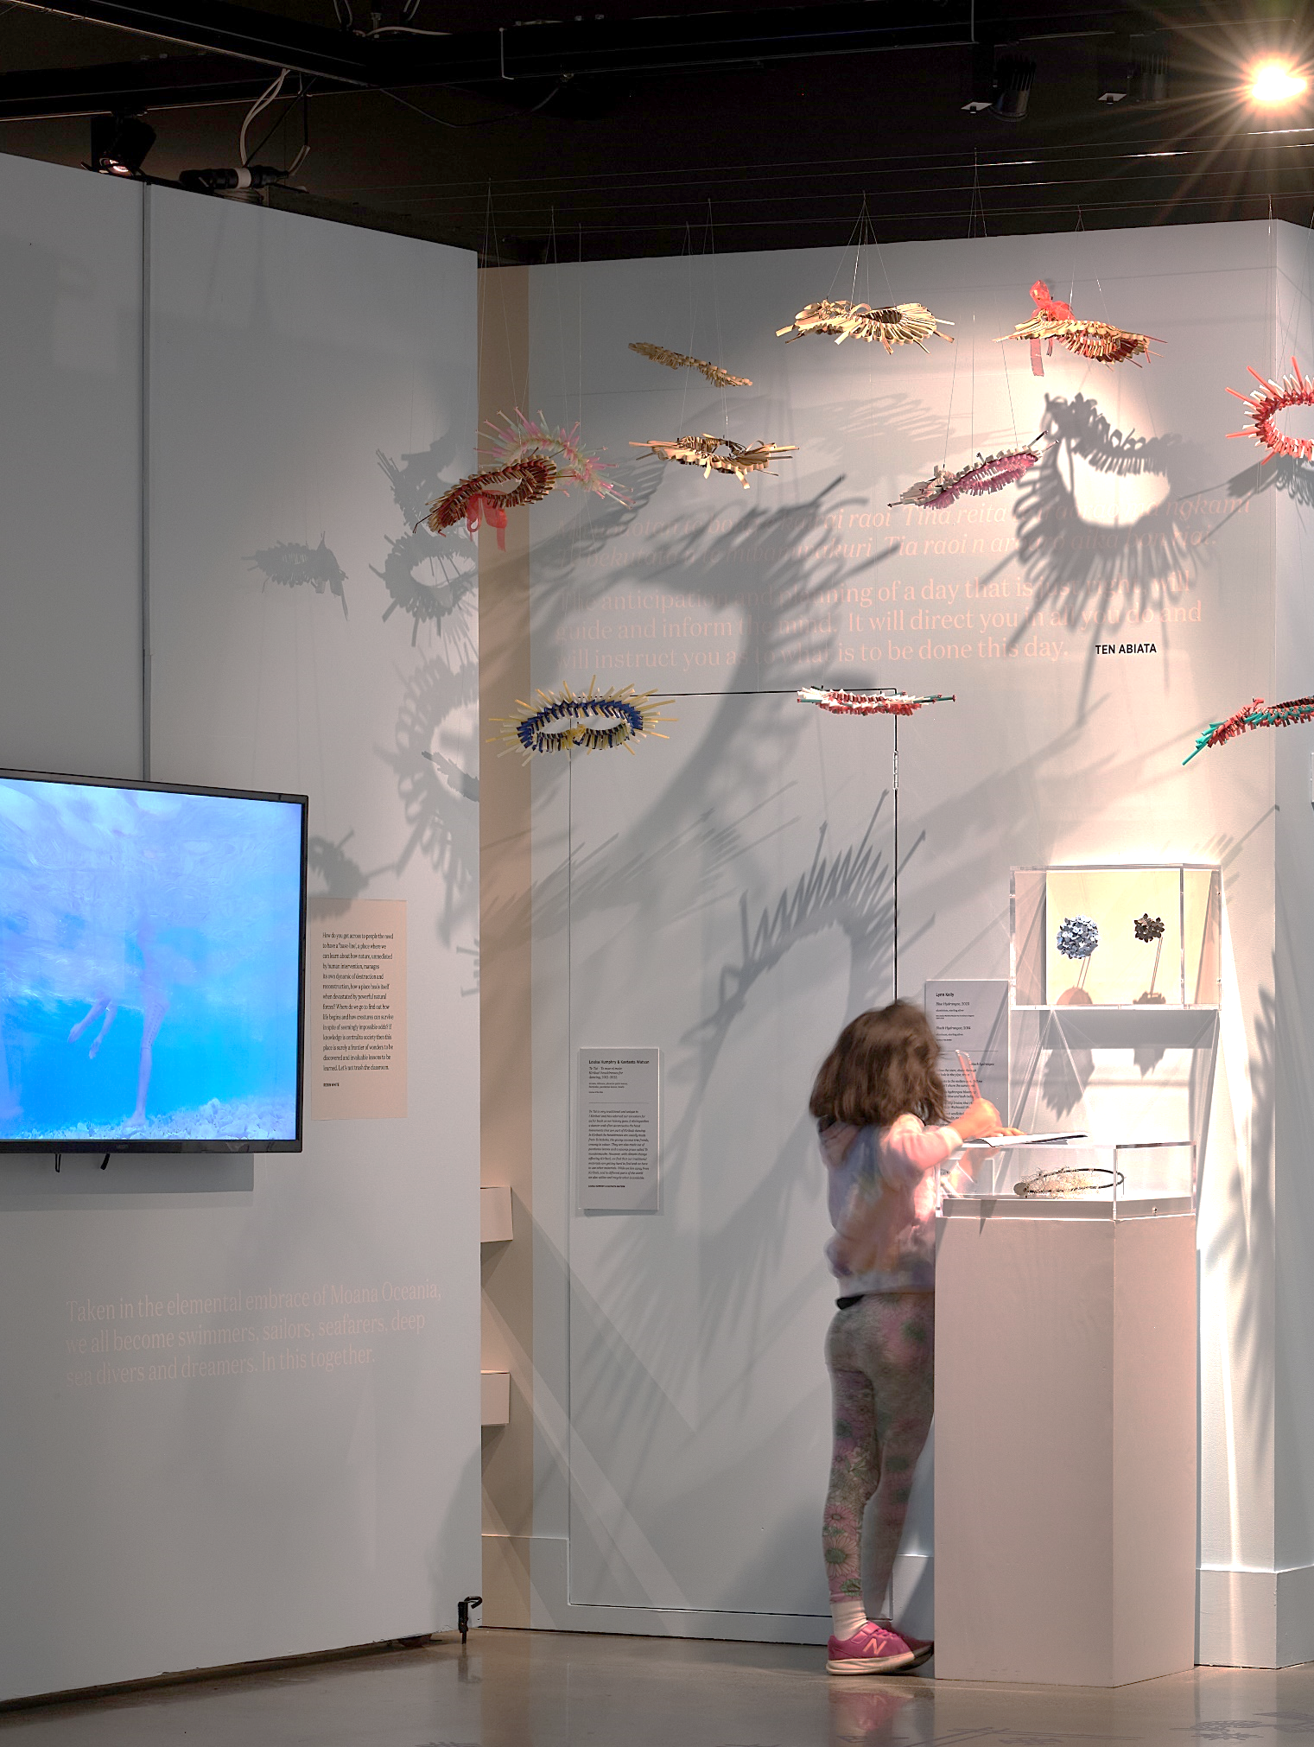
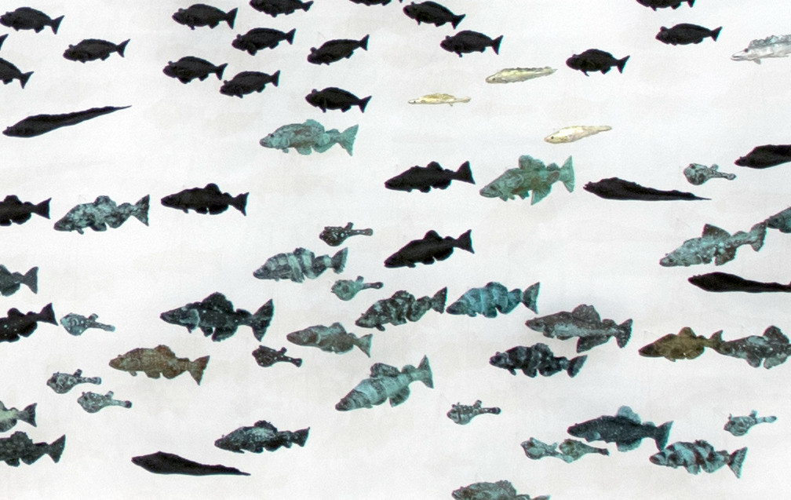
Label and wall text will be in English and Japanese.
Video works can be projected or displayed on monitors.
The exhibition is many-voiced and ongoing; there is the potential to include Japanese artists/poets.

Slide 7
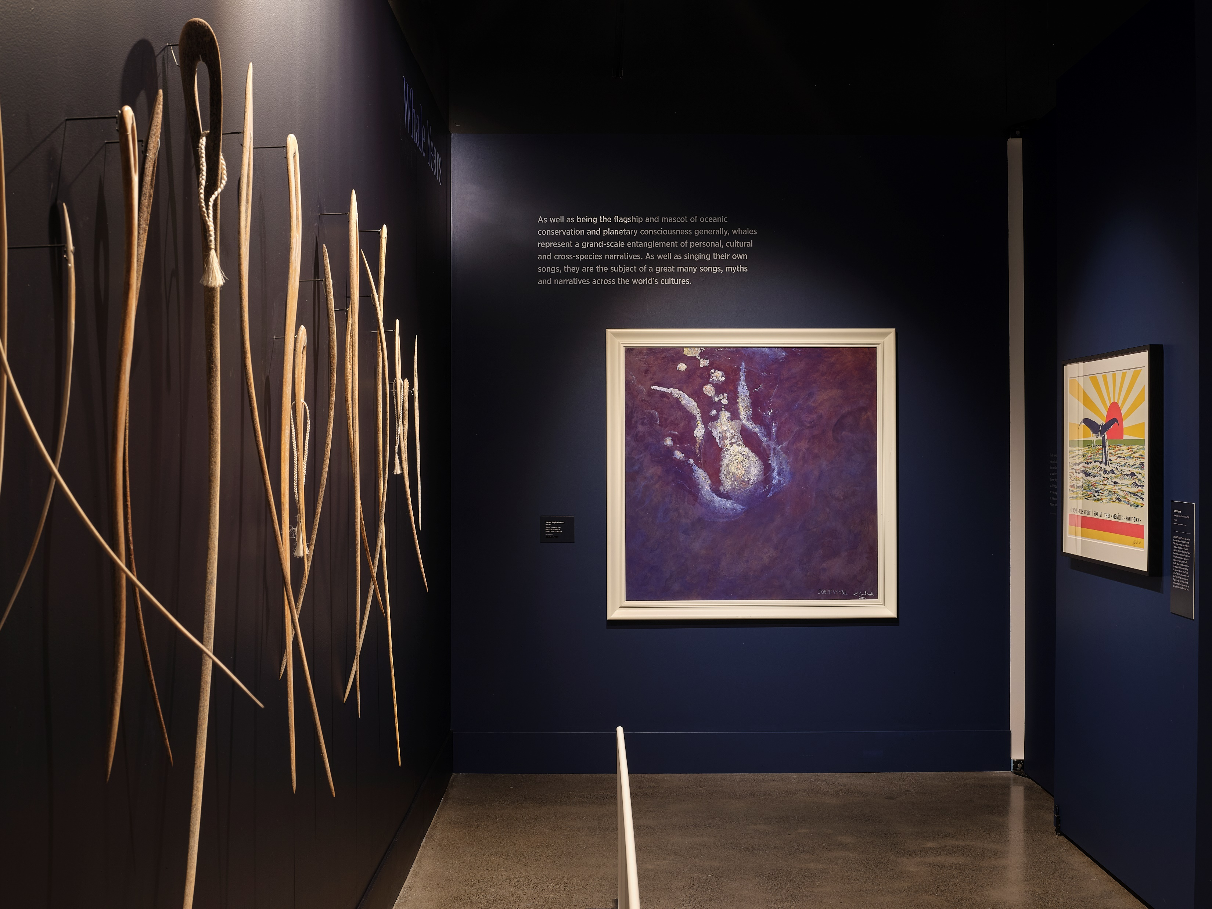

Slide 8
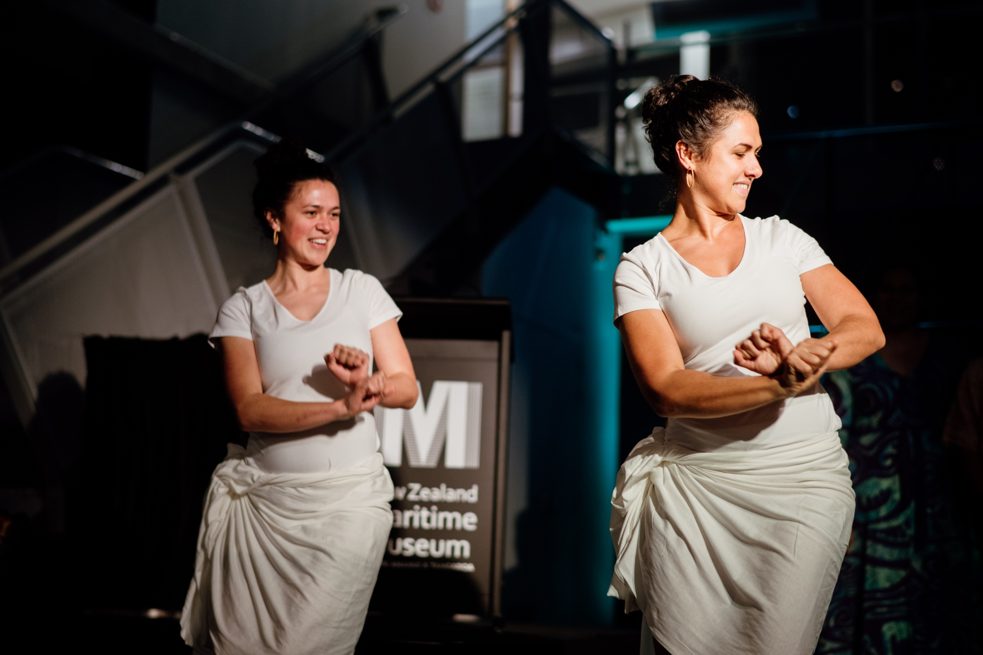
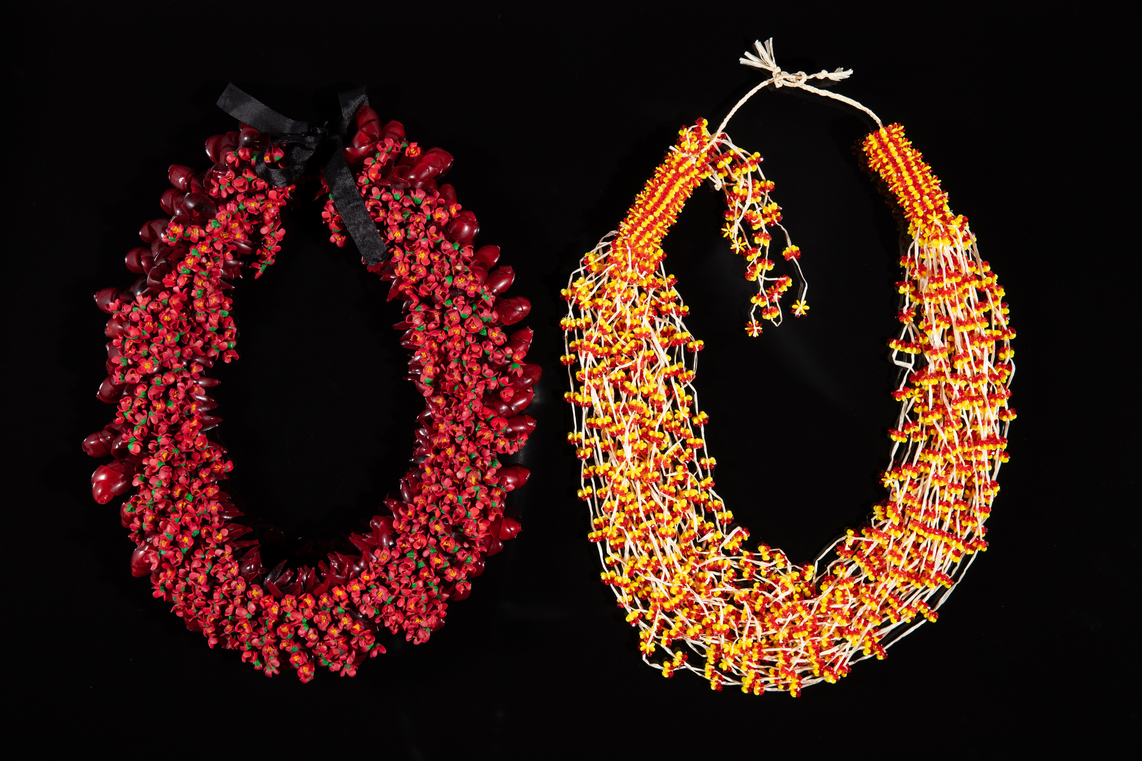
NZMM can supply information about public programmes staged during the 2023 exhibition and also share resources.
The exhibition fee will be set once venues have been confirmed, so that costs are distributed appropriately.
View the welcoming video to the exhibition here: https://www.youtube.com/watch?v=7D_xz_7L-u4&list=RD7D_xz_7L-u4&start_radio=1

Slide 9
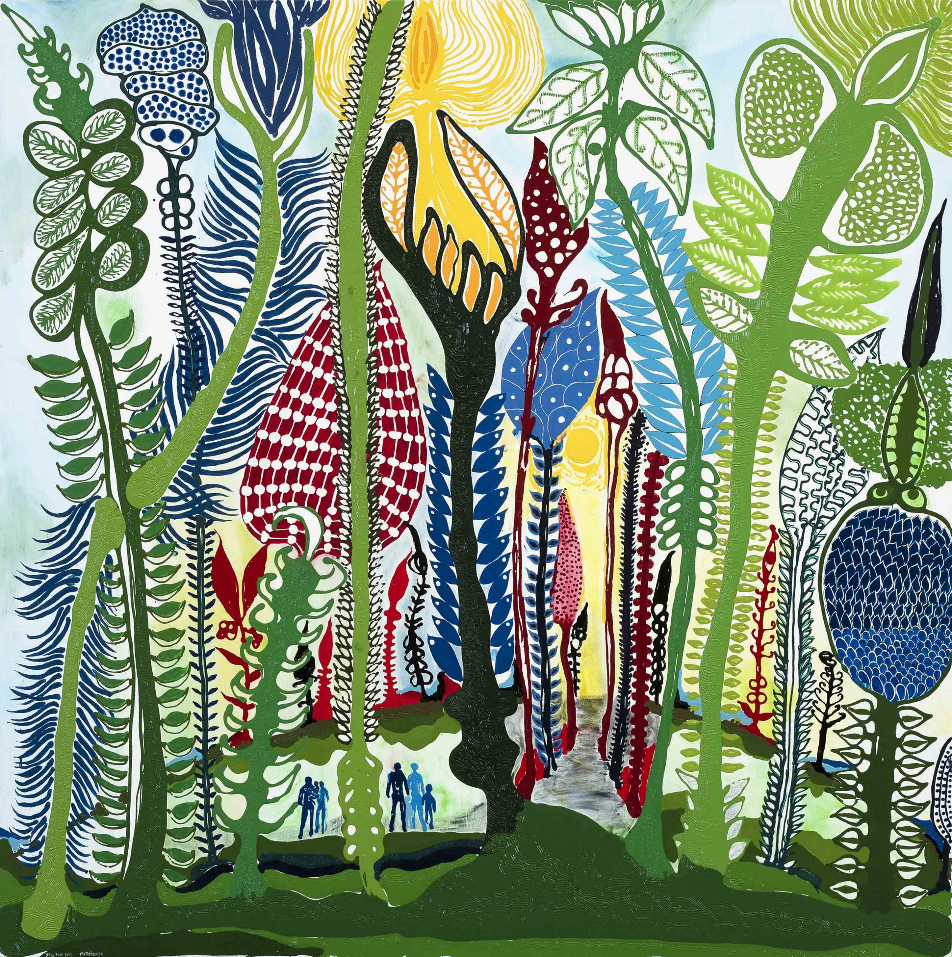
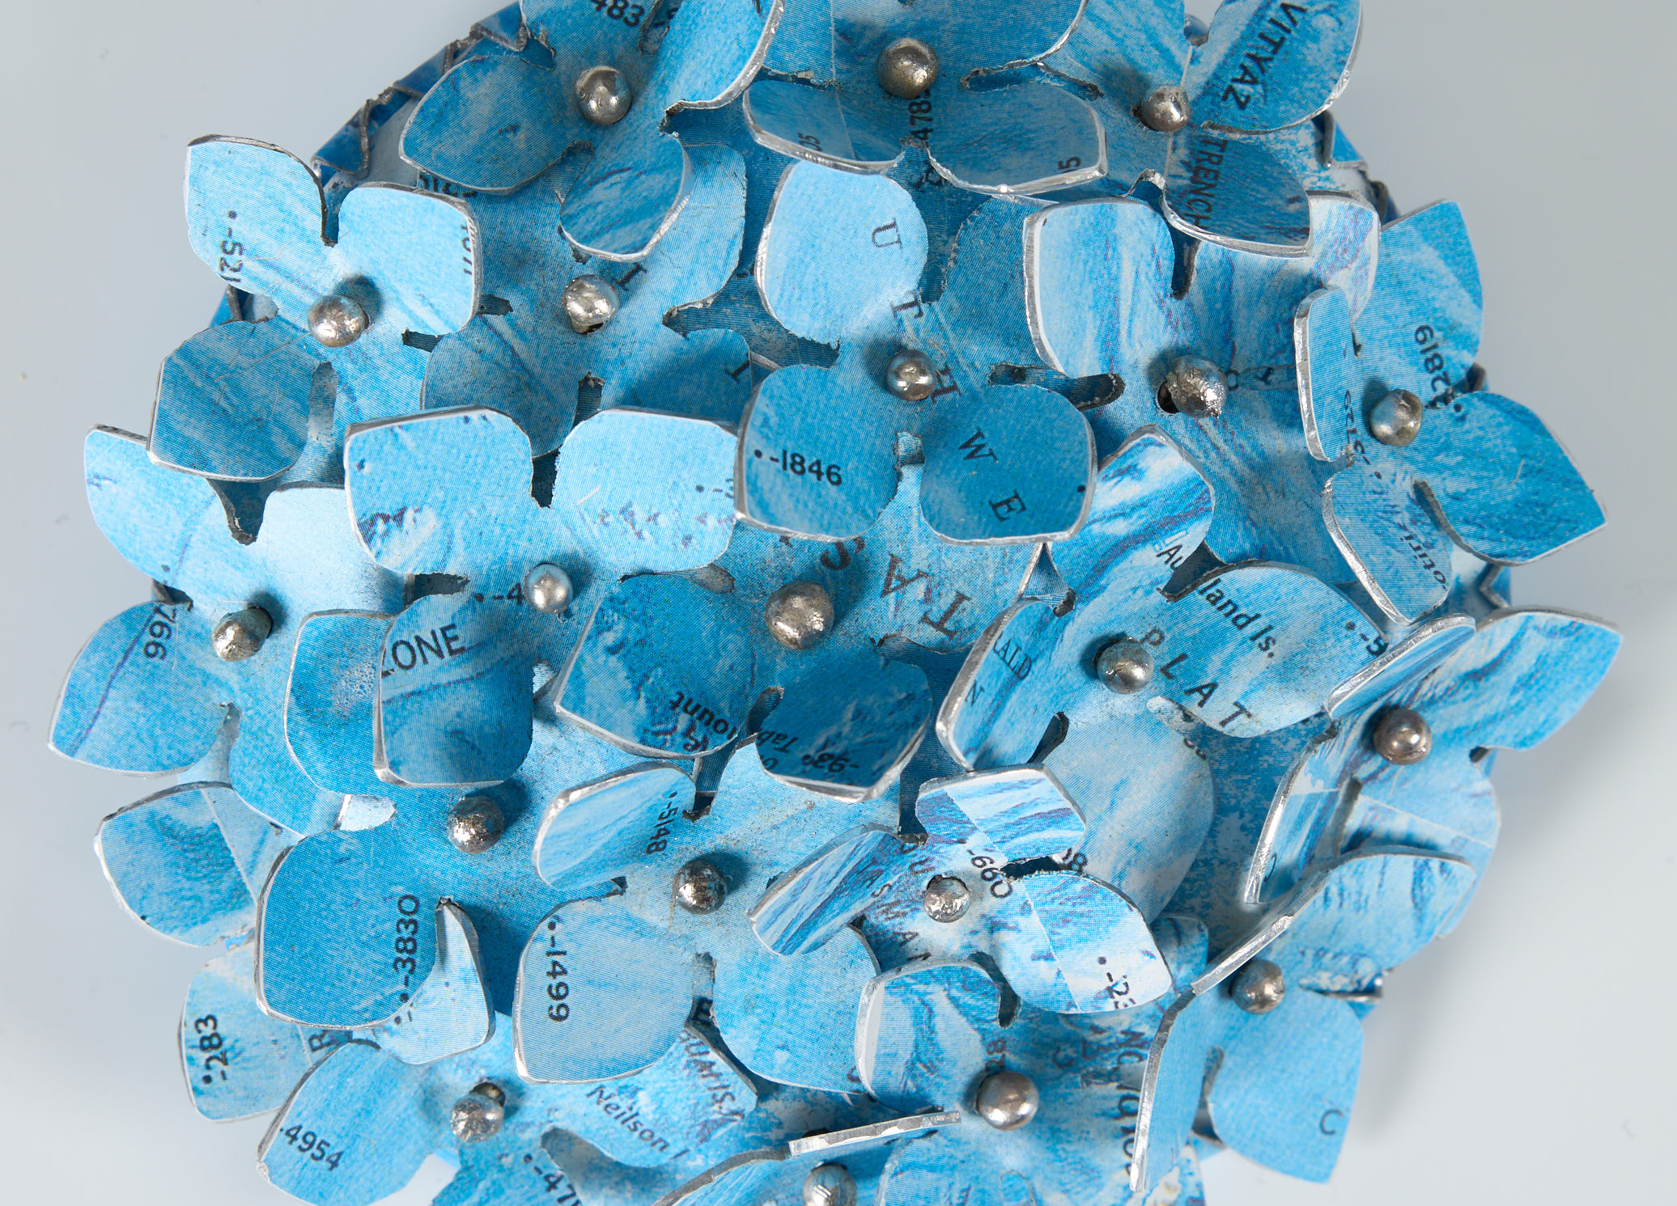
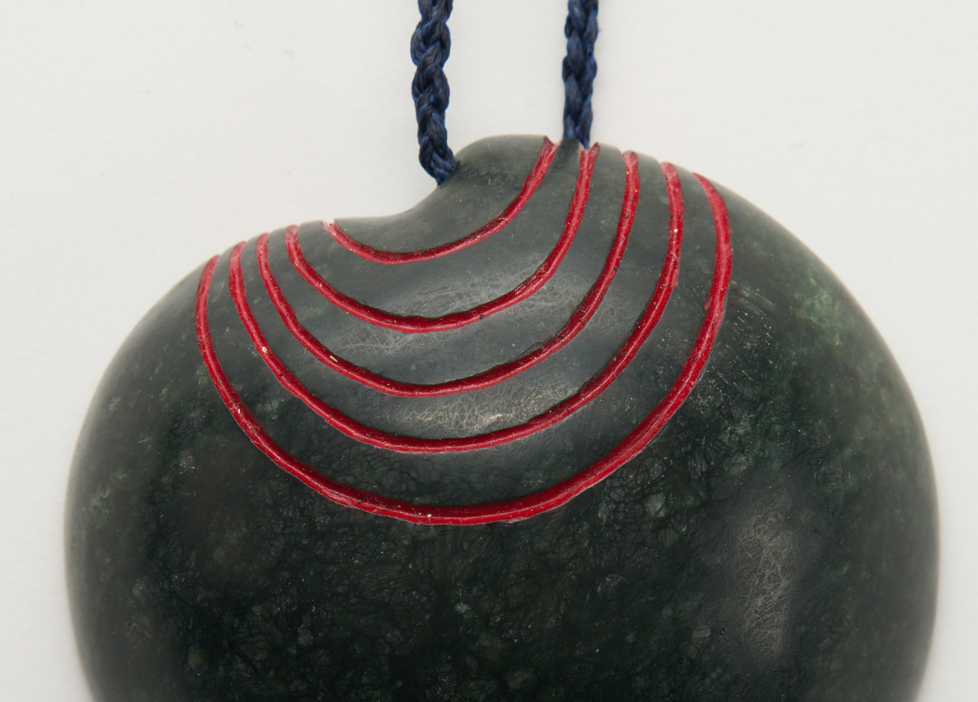

Slide 10


